Slide 1
UNSUPERVISED LEARNING
Jaya Sil
Bengal Engineering and Science University, Shibpur
Howrah-711103

Slide 2
UNSUPERVISED LEARNING
In unsupervised learning only input data (X) is given and no corresponding output variables.
The goal for unsupervised learning is to model the underlying structure or distribution in the data in order to learn more about the data.
If an input space is to be processed by a neural network, the first issue of importance is the structure of this space.
A neural network with real inputs computes a function f defined from an input space A to an output space B.

Slide 3
UNSUPERVISED LEARNING
During the training of ANN, the input vectors of similar type are combined to form clusters.
When a new input pattern is applied, then the neural network gives an output response indicating the class to which input pattern belongs.
No feedback from the environment as to what should be the desired output and whether it is correct or incorrect.
The network itself must discover the patterns, features from the input data and the relation for the input data over the output.

Slide 4
UNSUPERVISED LEARNING
The network discovers relationships of interest that may exist in the input data:- similarity, correlation in the input data
Translate the discovered relationship into outputs
The networks are called self-organizing networks
Unsupervised learning problems are grouped into clustering (discover inherent similarity or dissimilarity in the data) and association problems (discover rules describing association of data).
Examples :k-means for clustering and Apriori algorithm

Slide 5
Topographic Maps
Neurobiological studies indicate that different sensory inputs (motor, visual, auditory, etc.) are mapped onto corresponding areas of the cerebral cortex.
At each stage of representation, or processing, each piece of incoming information is kept in its proper context/neighbour.
Neurons dealing with closely related pieces of information are kept close together so that they can interact via short synaptic connections.
Goal is to building artificial topographic maps that learn through self-organization in a neurobiologically inspired manner.

Slide 6
KOHONEN NETWORK
Neurons work together to decode and process visual impressions.
The visual cortex is a well-studied region in the posterior part of the human brain.
Different sensory inputs are processed in different regions of cerebral cortex of our brain.
The visual information is mapped as one or two dimensional projection on the cortex.
Kohonen’s model has a biological and mathematical background.

Slide 7
KHONON NETWORK
The networks are called self-organizing networks
Winner-Takes-All Networks:
Networks are based on the competitive learning rule.
The output nodes try to compete with each other to
represent the input pattern.
During training, the output unit that has the highest activation to a given input pattern, will be declared the winner. This rule is also called Winner-takes-all because only the winning neuron is updated and the rest of the neurons are left unchanged.

Slide 8
KOHONEN NETWORK
y₁
x₁
y_{i}
x₂
y_{n}
x_{m}
W
The objective of a Kohonen network is to transform input vectors (patterns) of arbitrary dimension N onto a discrete map, and perform this transformation adaptively in a topologically ordered fashion.
The neurons of the input layer transfer signal to the neurons of the output layer.
The output layer neurons compete with each other, having eventually one of the units (say i) as the winner.

Slide 9
Theme is learn if win.
Competitive learning distributes the weight vectors to approximate the unknown probability density function of the random input vectors.
A competitive learning network performs an on-line clustering or similarity searching on the input patterns.
Algorithm uses distance measure between the input vector and weight vector and smallest distance is chosen as the winner.
Dot product between input and weight vector and largest is chosen as the winner.

Slide 10
KOHONEN NETWORK
y₁
x₁
y_{i}
x₂
y_{n}
x_{m}
W
The output layer neurons compete with each other, having eventually one of the units (say i) as the winner.

Slide 11
WINNER-TAKE-ALL
The weights connected with the winner neuron (say, k) are updated:
w_{kj}(t+1) = w_{kj}(t) - α(x_{j}-w_{kj}(t));
w_{kj}(t+1) = w_{kj}(t) if neuron k losses
α suitable learning constant.
The learning process stops when two consecutive weight changes are small enough.

Slide 12
SELF-ORGANIZING FEATURE MAP
Self organizing feature map follows winner takes all principle following spatial organization in the distribution of neurons.
Lattice of output neurons where neurons in the lattice space are arranged in 1D, 2D or even higher dimensions.
Feature mapping network converts patterns of arbitrary dimensionality into the responses of one or two dimensional arrays of neurons.
Map pattern space to feature space by reducing dimensionality.
The network obtains a topology preserving map by preserving neighbourhood relations of the input neuron.

Slide 13
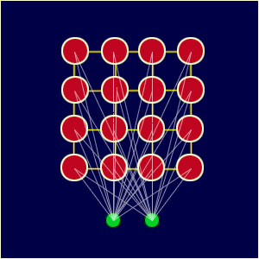
Consider the geometrical arrangements of output nodes.
Each node in a given layer has been identically connected with all of the nodes in the upper and/or lower layer.
Nodes that are "close" together are going to interact differently than nodes that are "far" apart.
More closely connected, more influence on other.
Each node has a specific topological position (an x, y coordinate in the lattice) and contains a vector of weights of the same dimension as the input vectors.

Slide 14
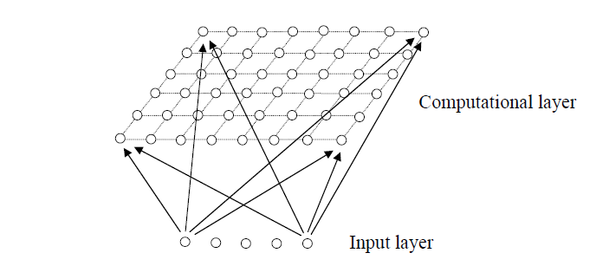
SOMs

Slide 15
Weights connected between input and output node where the output node is represented by the weight, different operation than supervised.
The node weights match the input vector, that area of the lattice is selectively optimized to more closely resemble the data for the class the input vector is a member of.
From an initial distribution of random weights, and over many iterations, the SOM eventually settles into a map of stable zones.
Each zone is effectively a feature classifier, so think of the graphical output as a type of feature map of the input space.

Slide 16
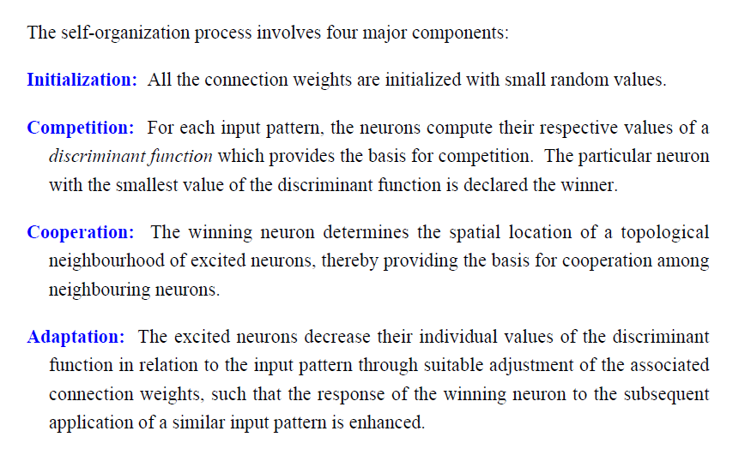

Slide 17
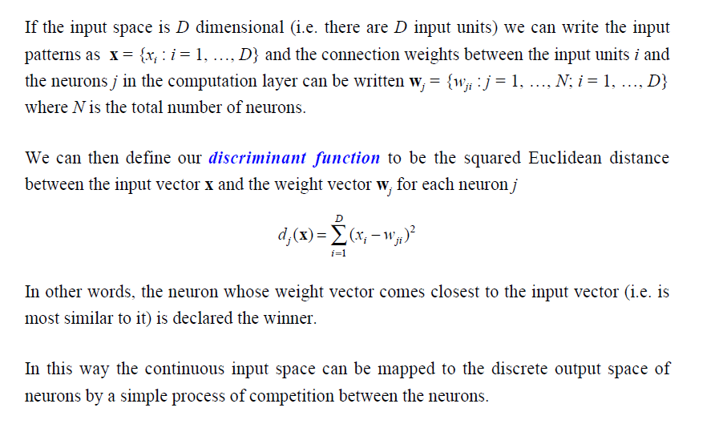
Competitions

Slide 18
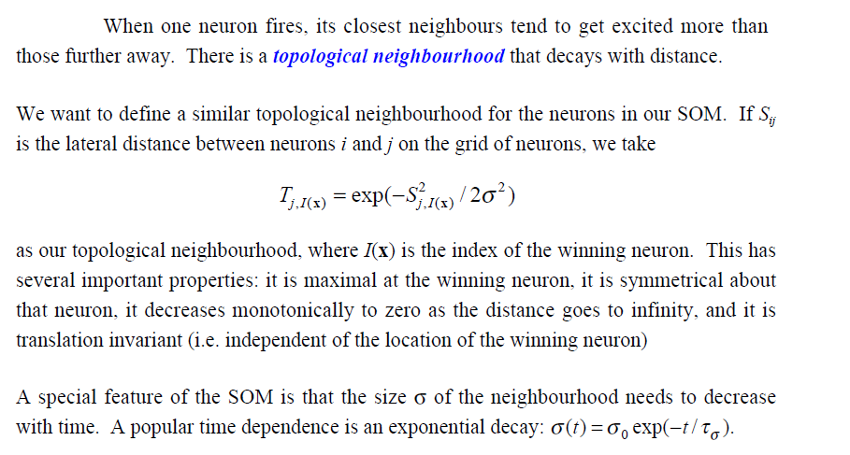
The Cooperative Process

Slide 19
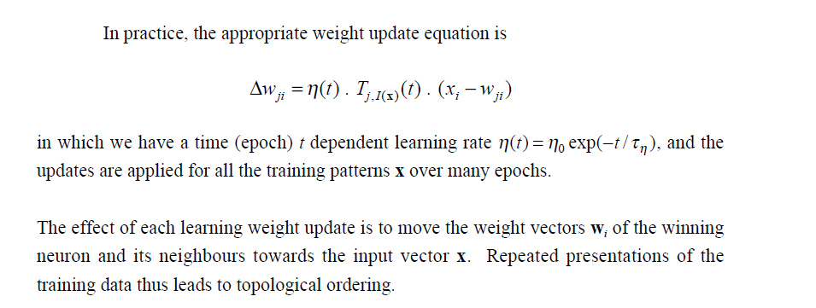
The Adaptive Process

Slide 20
A SOM does not need a target output to be specified
The node weights match the input vector, that area of the lattice is selectively optimized to more closely resemble the data for the class the input vector is a member of.
From an initial distribution of random weights, and over many iterations, the SOM eventually settles into a map of stable zones.
Each zone is effectively a feature classifier, so you can think of the graphical output as a type of feature map of the input space.

Slide 21
SOMs
Winner neuron goes close to the input and hence the other neuron as they are closely connected (neighbor).
Weights of all the neighbouring nodes are updated.
Close to the winner node updation is more and distant are less.
Neighbor is selected based on a topology.
Close nodes are dragged by the BMU depending on the distance.
After one epoch radius changes and process continues for different epochs.

Slide 22
TRAINING
1. Each node's weights are initialized.
2. A vector is chosen at random from the set of training data and presented to the lattice.
3. Every node is examined to calculate which one's weights are most like the input vector.
4. The winning node is commonly known as the Best Matching Unit (BMU).

Slide 23
5. The radius of the neighbourhood of the BMU is calculated.
6. This is a value that starts large, typically set to the 'radius' of the lattice, but diminishes each time-step.
7. Nodes found within this radius are deemed to be inside the BMU's neighbourhood.
8. Each neighbouring node's (the nodes found in step 4) weights are adjusted to make them more like the input vector. The closer a node is to the BMU, the more its weights get altered.
9. Repeat step 2 for N iterations

Slide 24
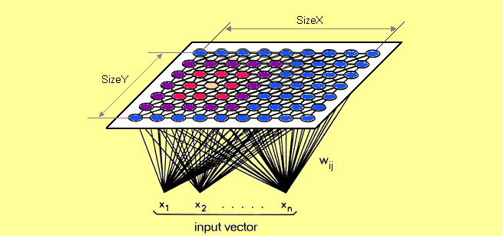

Input distributions are applied on the regular lattice (map) structure and the structure changes and physically move to the winning neuron by updating the weights.
Transforms complex inputs into easy to understand two
dimensional output by transferring synaptic strength
to its neighbours.

Slide 25
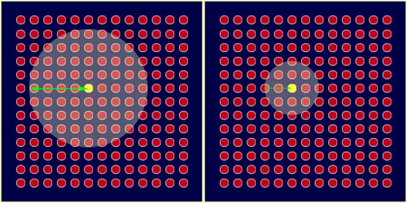
Property:
Topological neighbourhood is symmetric and lateral distance is monotically decreasing function
The weight vector is ‘moved’ closer towards the input vector for the winning neuron.
The amount of learning should decrease with distance for neighbouring neurons.

Slide 26
Autoencoders
Autoencoders are a specific type of feedforward neural networks where the input is the same as the output.
They compress the input into a lower-dimensional code and then reconstruct the output from this representation.
The encoder compresses input, and the decoder attempts to recreate the information from this compressed version.
An autoencoder consists of 3 components: encoder, code and decoder. The encoder compresses the input and produces the code, the decoder then reconstructs the input only using this code.

Slide 27
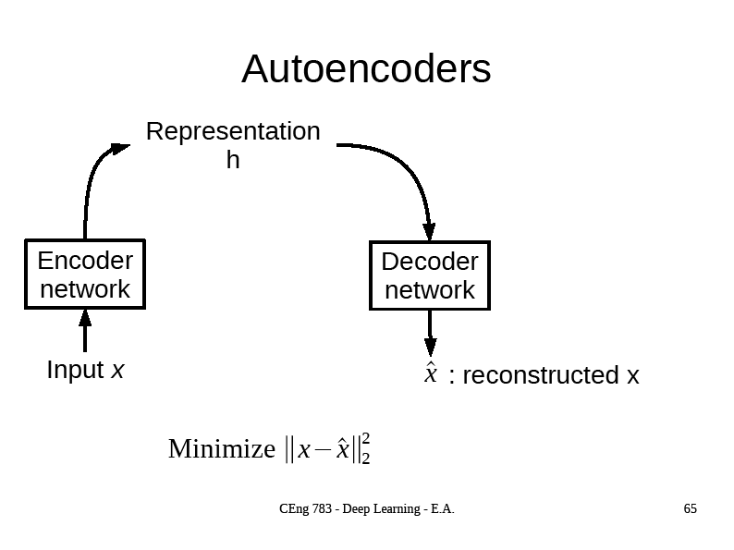

Slide 28
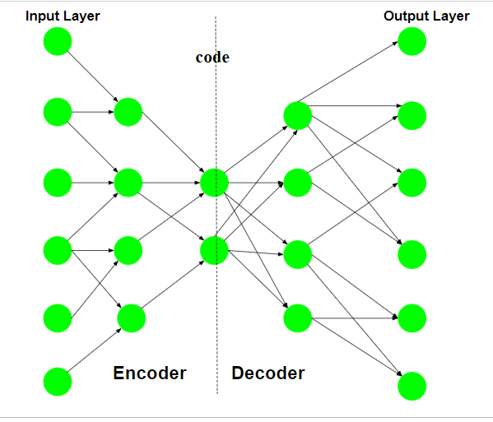
Architecture
Both the encoder and decoder are fully-connected feedforward neural networks, i.e. ANNs.

Slide 29
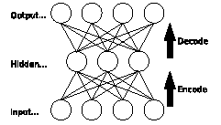


where, X_{i}’ is the reconstruction of input X_{i},
m represents the number of training samples.

Slide 30
Error Function
The choice of error function depends on the model.
If we consider a probabilistic model where the output layer is implemented by sigmoid or softmax activation function, then Cross Entropy Error (CEE) is the choice.
Similarly, if we assume the target data to be continuous and normally distributed, MSE is preferred.
Optimization techniques like gradient descent may be used to minimize the reconstruction error.

Slide 31
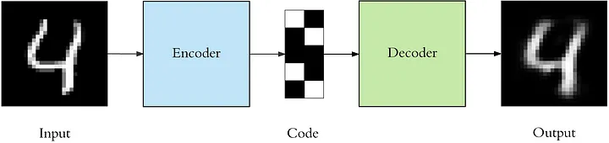
To build an autoencoder we need 3 things: an encoding method, decoding method, and a loss function to compare the output with the target.
Autoencoders are considered an unsupervised learning technique since they don’t need explicit labels to train on.
But to be more precise they are self-supervised because they generate their own labels from the training data.

Slide 32
First the input passes through the encoder, which is a fully-connected ANN, to produce the code.
The decoder, which has the similar ANN structure, then produces the output only using the code.
The goal is to get an output identical with the input.
The only requirement is the dimensionality of the input and output needs to be the same.
This network can be trained by minimizing the reconstruction error , which measures the differences between our original input (x) and the consequent reconstruction (x′).
Autoencoders are trained the same way as ANNs using backpropagation.

Slide 33
Hyperparameters
Code size: number of nodes in the middle layer. Smaller size results in more compression.
Number of layers: the autoencoder can be as deep as we like.
Number of nodes: The number of nodes per layer decreases with each subsequent layer of the encoder, and increases back in the decoder.
Loss function: Cross entropy can be applied in both binary and multi-class classification problems.

Slide 34
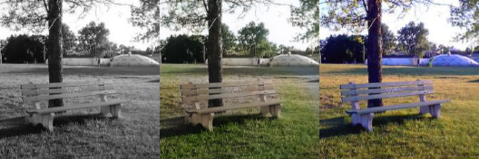
Autoencoders: Applications
Image colorization: input black and white and train to produce color images
https://www.edureka.co/blog/autoencoders-tutorial/

Slide 35
Loss Function
The gradient descent optimization algorithm to find the optimal parameters (weights and biases) of the network.
In this process, there’s a loss function that tells the network how good or bad its current prediction is.
The goal of optimization is to find those parameters that minimize the loss function: the lower the loss, the better the model.
In classification problems, the model predicts the class label of an input.

Slide 36
Cross-entropy losses
Cross-entropy loss gives information on how correct a particular prediction is.
When training a classifier neural network, minimizing the cross-entropy loss during training is equivalent to helping the model learn to predict the correct labels with higher confidence.
Binary and categorical cross-entropy losses, used for binary and multiclass classification, respectively.

Slide 37
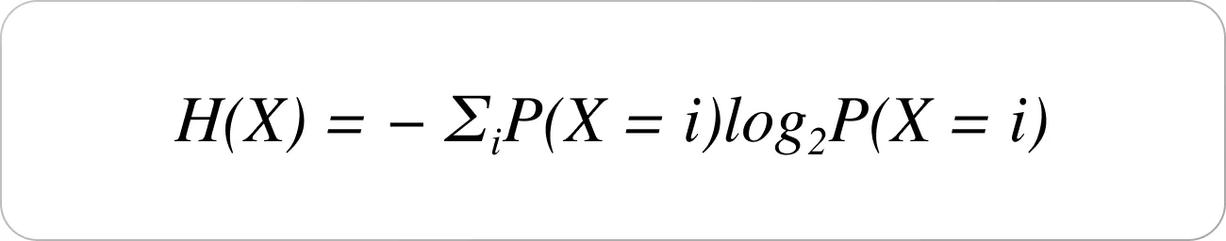
Entropy
Claude Shannon introduced the concept of information entropy in his 1948 paper, “A Mathematical Theory of Communication.
According to Shannon, the entropy (H(X) of a random variable (X) is the average level of “information,” “uncertainty” inherent in the variable’s possible outcomes.
entropy indicates the amount of uncertainty of an event. Problem of determining the fair coin toss outcome as an example. we have two outcomes p[X=H] = p[X=T] = 1/2

Slide 38
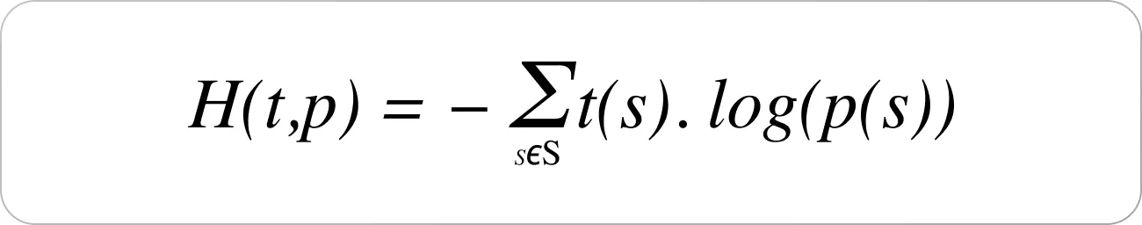
Cross-entropy builds upon the idea of information theory entropy and measures the difference between two probability distributions for a given random variable/set of events.
Given a true distribution t and a predicted distribution p, the cross entropy between them is given by

Slide 39
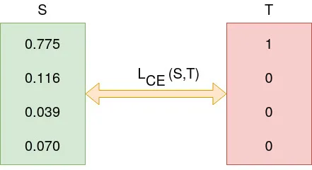
The desired output is [1,0,0,0] for the class, say dog but the model outputs [0.775, 0.116, 0.039, 0.070]
During model training, the model weights are iteratively adjusted accordingly with the aim of minimizing the Cross-Entropy loss.

Slide 40
Cross-Entropy loss
Cross-entropy loss, or log loss, measures the performance of a classification model whose output is a probability value between 0 and 1.
The lower the loss the better the model.
Cross-Entropy loss is a most important cost function, used to optimize classification models.
The purpose of the Cross-Entropy is to take the output probabilities (p) and measure the distance from the truth values.
Cross-entropy loss increases as the predicted probability diverges from the actual label.

Slide 41
Cross entropy loss
Cross entropy loss is a metric used in machine learning to measure how well a classification model performs.
The loss (or error) is measured as a number between 0 and 1, with 0 being a perfect model.
The objective is to minimize the loss function as close to 0 as possible.
Binary cross entropy loss (or log loss) is used in scenarios where there are only two possible outcomes.
A loss function if doesn't penalize wrong output appropriately to its magnitude, it can delay convergence and affect learning.

Slide 42
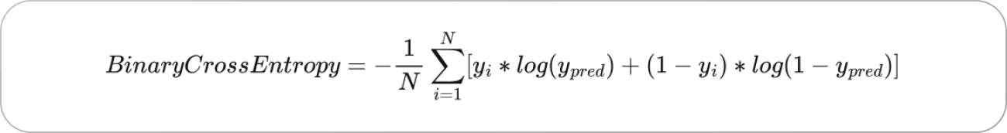
where:
y_{pred} = p is the predicted probability, and
y_{i} is the indicator (0 or 1 in the case of binary classification )
There's a learning paradigm called Maximum Likelihood Estimation (MLE) which trains the model to estimate its parameters so as to learn the underlying data distribution.
Thus, we use a loss function to evaluate how well the model fits the data distribution.
Using cross-entropy, we can measure the error (or difference) between two probability distributions.
In the case of Binary Classification, cross-entropy is given by
If there are N samples in the dataset, then the total cross-entropy loss is the sum of the loss values over all the samples in the dataset.

Slide 43
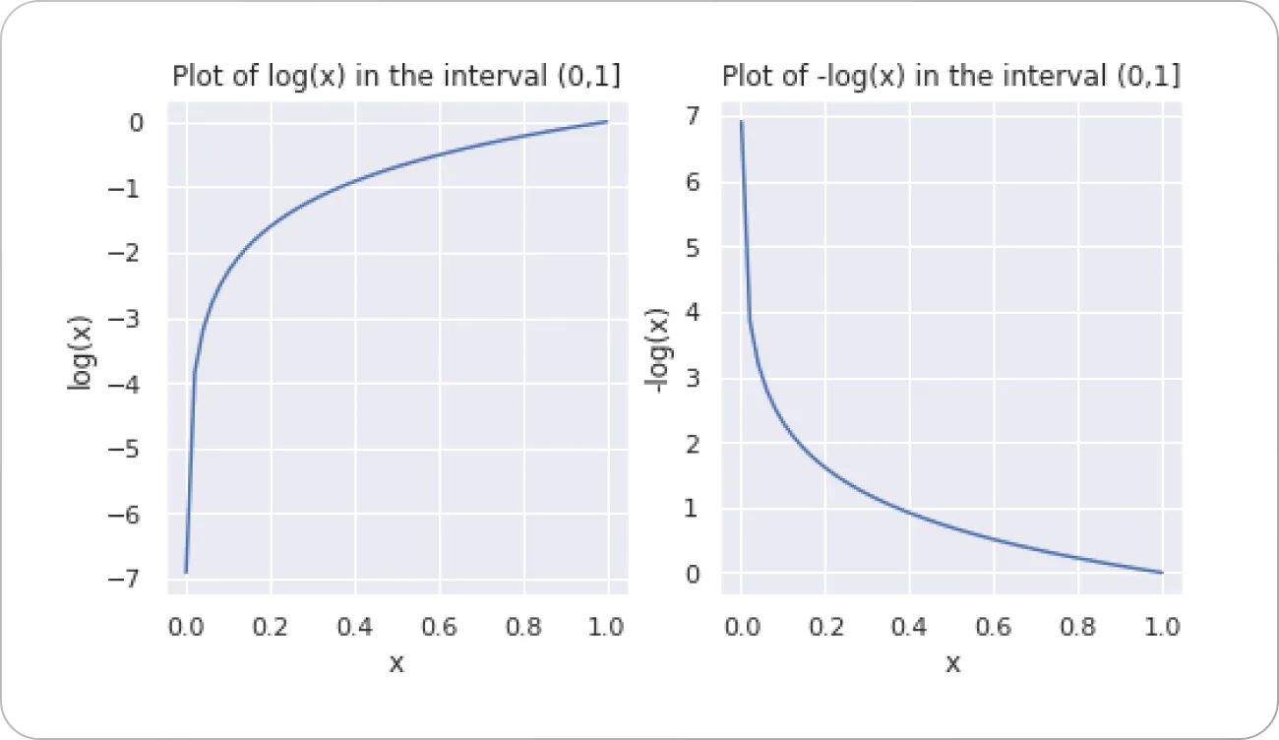
In the interval (0,1), log(x) and -log(x) are negative and positive, respectively.
-log(x) approaches 0 as x approaches 1
As the predicted probability approaches 1, log loss slowly decreases

Slide 44
The value of loss l thus depends on the probability p.
Therefore, the loss function will reward the model for giving a correct prediction (high value of p) with a low loss.
If the probability is lower, the value of the error will be high (bigger negative value), and therefore it penalizes the model for a wrong outcome.
So predicting a probability of 0.012 when the actual observation label is 1 would be bad and result in a high loss value.

Slide 45
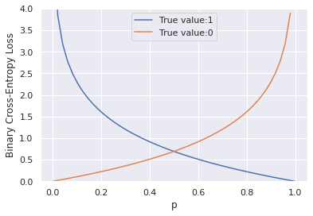

When t = 1, the second term is zero, and loss becomes −log(p).
Therefore, when t =1, the binary cross-entropy loss is equal to the negative logarithm of the predicted probability p.
Similarly, when the true label t=0, the term t.log(p) vanishes, and loss is −log(1−p)
The binary cross-entropy loss for different values of the predicted probability p.

Slide 46
Observations
When the true label t is 1, the cross-entropy loss approaches 0 as the predicted probability p approaches 1 and
When the true label t is 0, the cross-entropy loss approaches 0 as the predicted probability p approaches 0.
In essence, the cross-entropy loss attains its minimum when the predicted probability p is close to the true value and is substantially higher when the predicted probability is far away from the true label.

Slide 47
But which predictions does cross-entropy loss penalize the most?
log (0) → - ∞ so - log (0) → ∞
Happens when the network outputs p=1 or a value close to 1 when the true class label is 0, and outputs p=0 or a value close to 0 when the true label is 1.
Cross-entropy loss increases drastically when the network makes incorrect predictions with high confidence.

Slide 48
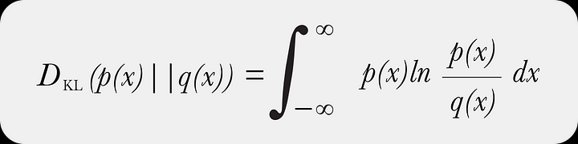
Kullback-Leibler divergence
Kullback-Leibler divergence metric (relative entropy) is a statistical measurement from information theory that is commonly used to quantify the difference between one probability distribution from a reference probability distribution.
It can be thought of as measuring the distance between two data distributions showing how different the two distributions are from each other.

Slide 49
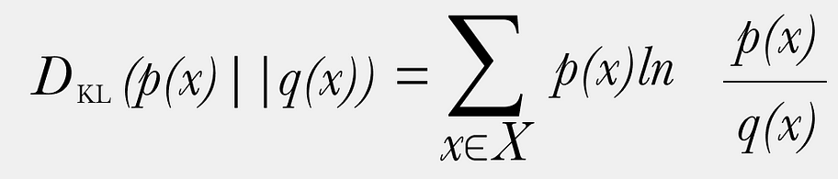
Discrete data Distribution
KL divergence is typically applied to each feature independently; it is not designed as a covariant feature measure but rather a metric that shows how each feature has diverged independently from the baseline values.

Slide 50
KL Divergence
The cross entropy between two discrete probability distributions is related to KL divergence, a metric that captures how close the two distributions are.
Given a true distribution t and a predicted distribution p, the cross entropy between them is H(t, p) = - t(s) . log (p(s)); s∈ S
Here, both t and p are distributed on the same source S, but could take potentially different values.
For three-element S, if t = [t1, t2, t3] and p = [p1, p2, p3], it’s not necessary that t_i = p_i for i in {1,2,3}.
Note: log(x) refers to log to the base e (or natural logarithm), also written as ln(x)

Slide 51
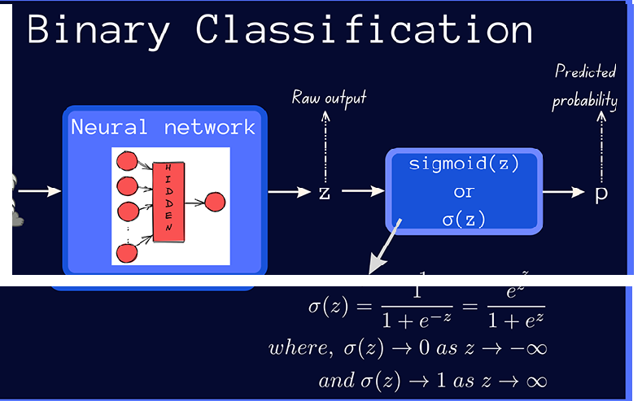
In binary classification, the sigmoid activation is used in the output layer, and the neural network outputs a probability score (p) between 0 and 1; the true label (t) being one of {0, 1}.

Slide 52
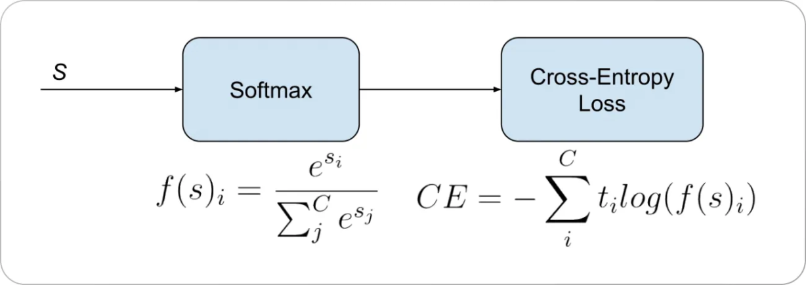
Multiclass classification
A softmax activation plus a Cross-Entropy loss used for multiclass classification.
In multiclass classification, the outputs of the neural network are passed through the softmax activation, which then outputs a vector of predicted probabilities over the input classes.
f(s)_{i} = p_{i}
Vector of probabilities
A perfect model would have a log loss of 0.

Slide 53

Categorical cross-entropy loss fn.
The label as the target
The categorical cross-entropy loss function is commonly used in neural networks with softmax activation in the output layer for multi-class classification tasks.
By minimizing loss, the model learns to assign higher probabilities to the correct class while reducing the probabilities for incorrect classes, improving accuracy.

Slide 54
In case of multiclass classification, we use the softmax activation at the output layer to get a vector of predicted probabilities p.
The true distribution t contains all of the probability mass (1) at the index of the correct class, and 0 everywhere else.
For example, in a classification problem with N classes, the true distribution corresponding to class i is a vector that’s N classes long, with 1 at the index of the class label i and 0 at all other indices.

Slide 55
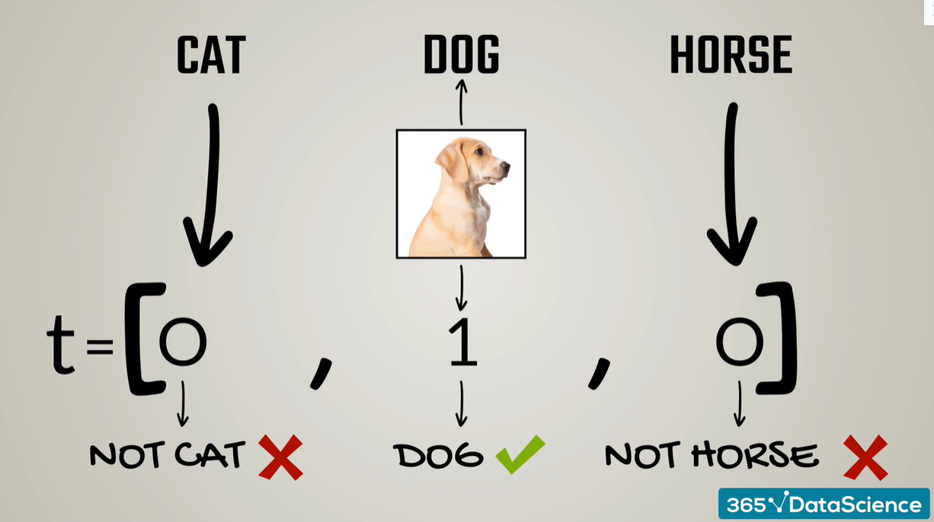
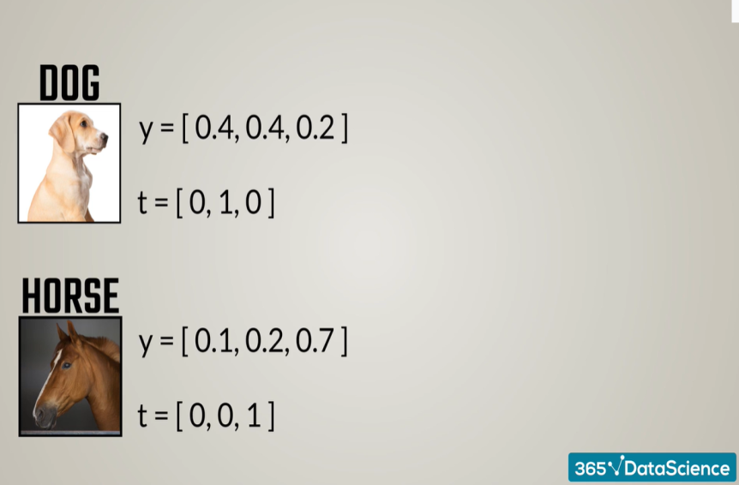
The true distribution t is a one-hot vector that has 1 at one of the indices and zero everywhere else.
After transformations, these vectors show the probabilities for each image: a cat, dog, or horse.

Slide 56
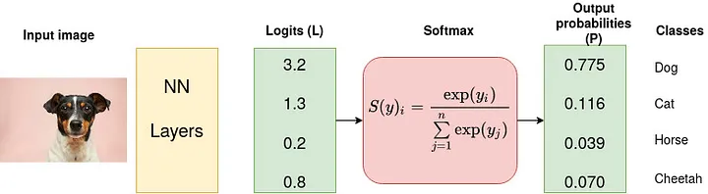
The understanding of Cross-Entropy is plugged on understanding of Softmax activation function, in multiclass classification problem.
Consider a 4-class classification task where an image is classified as either a dog, cat, horse or cheetah.
Softmax converts logits into probabilities.
The purpose of the Cross-Entropy is to take the output probabilities (P) and measure the distance from the truth values .
The logit is defined logit p = σ⁻¹ p) = ln (p/1-p) for p∈ (0, 1)
Logit is a type of function that maps probability values from (0, 1) to real numbers (-∞, +∞)

Slide 57
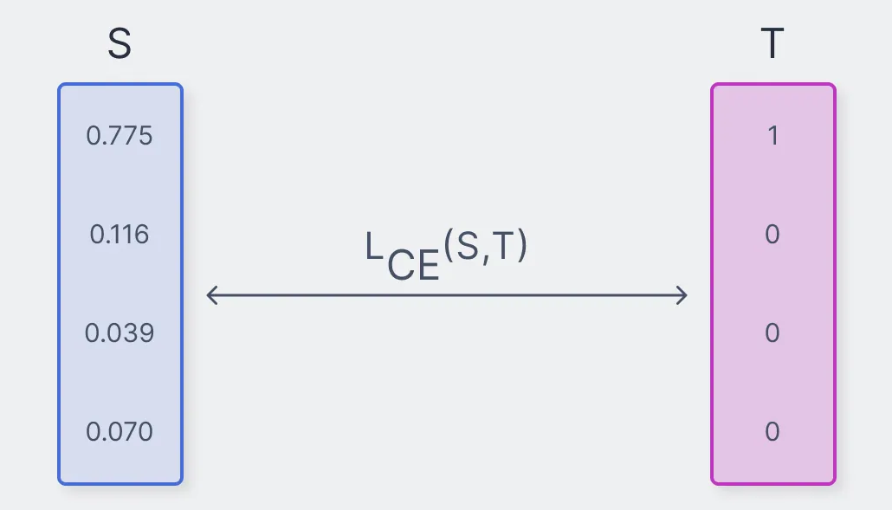

Slide 58
Activation Function
A weight will learn slowly if either the input neuron is low-activation, or if the output neuron has saturated.
Choose an activation function σ so that σ′ is always positive, and never gets close to zero.
This would prevent the slow-down of learning that occurs when ordinary sigmoid neurons saturate.
Activation function should be antisymmetric: σ(−y) = −σ(y)
The actual performance of back propagation on a specific problem is dependent on the input data.

Slide 59
Local Minima
Stuck at a local minimum means we have a locally good optimization of our parameters, but there is a better optimization somewhere on our loss surface.
Neural network loss surfaces can have many of these local optima, which is problematic for network optimization.
Solution: Batch and Stochastic Gradient Descent.
To use a batch (a subset) of data as opposed to the whole set of data.
The loss surface is partially changed during each iteration.

Slide 60
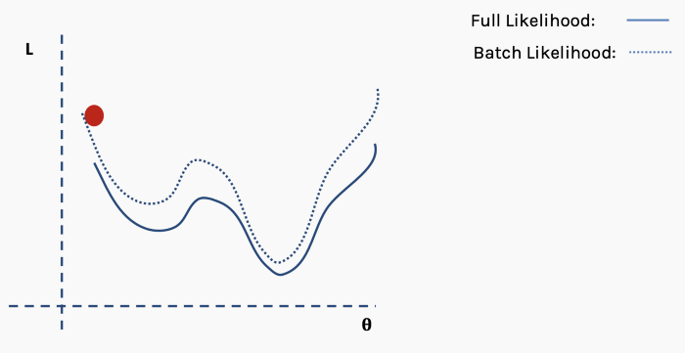
select a batch of data, say,10% of the full dataset, and construct a new loss surface.

Slide 61
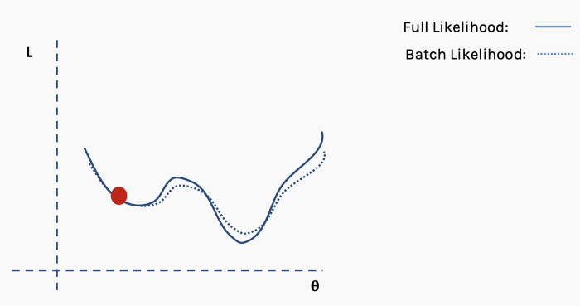
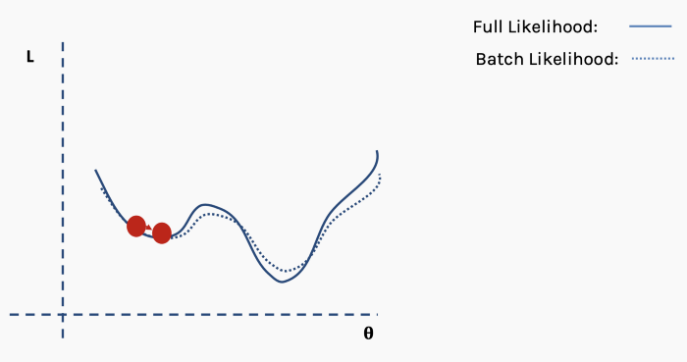
Select a new random subset of the full data set and again construct loss surface.

Slide 62
PROBLEM SOLVING
Select a suitable NN model based on the nature of the problem.
Construct a NN according to the characteristics of the application domain.
Train the neural network with the learning procedure of the selected model.
Use the trained network for making inference or solving problems.

Slide 63
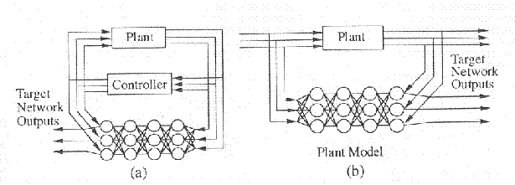
APPLICATIONS - Control Systems
  Complex dynamical systems with uncertainty.
  Systems identification and control.
  Adaptively change the neural controller based on the critic signal.
  Identify system failures and store Information for decision making.

Slide 64
Example:
Two dimensional problem- Feature vector x=(x₁, x₂)
x₁: systolic blood pressure and x₂: white blood count
Two class problem- Class 1 : M1 and Class 2: Angina
Decision Surface: D(x) = w₁x₁ + w₂x₂
D(x) > 0; if x belongs class 1
D(x) < 0; if x belongs class 2.
Perceptron learning rule: w_{i}(t+1) = w_{i}(t) +η[d(t) - y(t)]x_{i}(t)
y(t) = 1; if D(x) > 0
y(t) = -1; if D(x) < 0
d(t)=1; if x belongs to class 1
d(t)=-1; if x belongs to class 2

Slide 65
PATTERN CLASSIFICATION
Determine Parameters (Features) able to distinguish between different classes.
Feature extraction.
Feature extraction requires domain knowledge.
Decision Surface (separator) that divides the classes.
20
w
h
i
t
e
B
l
o
o
d
C
o
u
n
t
10
0
15
30
Systolic Blood Pressure /100

Slide 66
BIOMEDICAL APPLICATIONS
Clustering for classification of cell types.
Clustering and Dimensionality Reduction.
Global classification of known Protein sequences.
Segmentation of Protein sequences

Slide 67
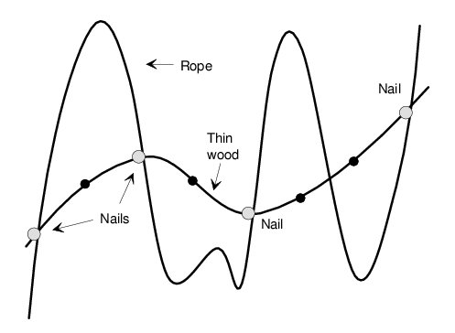
OVER-FITTING
Be sure that the number of trainable weights influencing any particular output is smaller than the number of training samples

